Slide 2
Media Use in Zimbabwe
Findings from the 2012 International Audience Research Project
Notes:
Thank you, Chris.
Good morning, everyone. My name is Jenna Levy and I am a Consulting Specialist here at Gallup.
Today, we will be presenting key findings from the 2012 media use survey in Zimbabwe, as well as recommendations for how broadcasters can best reach Zimbabweans today.

Slide 3
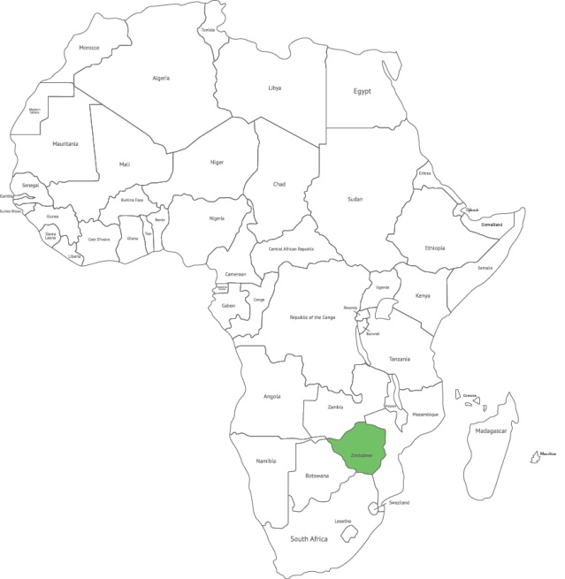
Methodology
Notes:
I’m going to start off with an overview of the survey methodology, including details on data collection and sampling.

Slide 4
Methodology: Data Collection
Target population: Adults ages 15 and older living in Zimbabwe
Sample size: 1,512
Mode: Face-to-face interviews in respondents’ homes
Languages: English, Shona, Ndebele
Response rate: 83.2%
Field period: July 22 - August 2, 2012
Field team: 5 supervisors; 31 interviewers

Slide 5
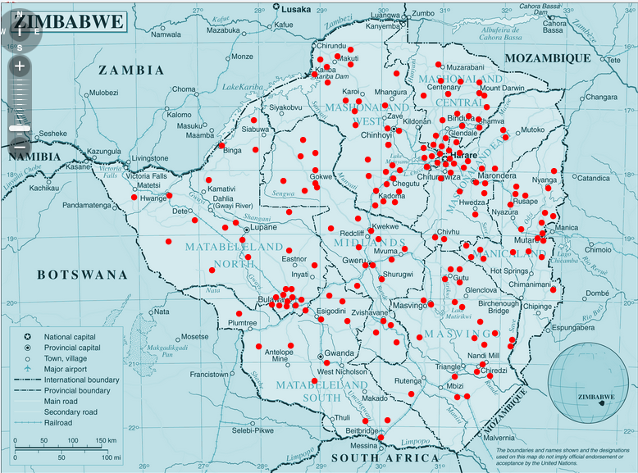
Methodology: Sampling Plan
Provinces: 10
PSUs: 189
Interviews per PSU: 8
Within household selection: Kish method
Notes:
The sample was first stratified by each of the 10 provinces, and then within province by 6 population-defined strata to give us 189 primary sampling units.
8 interviews were conducted in each of the 189 PSUs.
In urban areas, each PSU represents a ward or neighborhood. In rural areas, a PSU represents a village.
To allow for randomization at the respondent level, interviewers selected respondents using the Kish grid methodology.

Slide 6
Methodology: Challenges in Field Work
Political intimidation and suspicion
Respondent wariness to participate or answer truthfully
Zanu PF youth inquisition
Assumption of Zimbabwean government involvement in research
Logistical obstacles
Acquiring permission from chiefs or headmen
Notes:
Conducting survey research in this part of the world is never an easy task.
In Zimbabwe this was further complicated by a few unique challenges:
The unstable political environment has caused people to be suspicious of strangers. Respondents were wary to participate and provide truthful answers.
The ZANU PF Youth continuously questioned and harassed interviewers for paperwork and documentation, making fieldwork somewhat of a challenge.
Respondents also were concerned this research was really for the government-controlled TV channel, ZBC. This further lead to potential masking of answers.
Additionally, we experienced logistical obstacles. In rural villages, the chief or headmen requested extra documentation before interviewing could proceed. This sometimes meant a supervisor had to travel a long distance to get documentation, which affected the field work schedule.

Slide 7
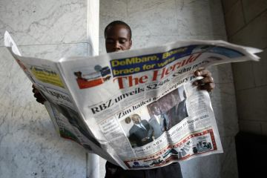
Media Landscape
Photo: cpj.org
Photo: Globalpost.com
Notes:
The media landscape in Zimbabwe is in many ways very traditional, but we also have evidence that Zimbabweans are actually relying on a unique mix of media for news and information.
Additionally, you’ll see that different subgroups have varying levels of access and usage of sources.

Slide 8
3 in 4 Households Have Mobile Phone; Half Have TV
Which, if any, of the following do you have working in your household? (n=1,512)
Notes:
While conventional thinking would have us believe radios would be the most common type of equipment Zimbabweans would have at home, we see here that newer media is actually quite established --- 76% of Zimbabweans have a mobile phone in the household, and 47% report having a TV.
While only 10% report having a computer, 19% report having Internet access at home, which suggests many people are accessing the Internet via a mobile device.

Slide 9
Access Gaps Observed in TV, Internet Between Urban and Rural Areas
Which, if any, of the following do you have working in your household?

Slide 10
Word of Mouth, Radio Most Prevalent News Sources
How often do you access news from each of the following sources? Results among total sample (n=1,512)
Notes:
Zimbabweans are as likely to say they get news from SMS as they are to say they get it from TV

Slide 11
Media Consumption Differs Between Urban, Rural
How often do you access news from each of the following sources? Percent who use each source at least once a week

Slide 12
Ndebele More Likely Than Shona to Rely on Word of Mouth
How often do you access news from each of the following sources? Percent who use each source at least once a week

Slide 13
Radio is Choice Source Among All, but Youth Most Likely to Also Use New Media
How often do you access news from each of the following sources? Percent who use each source at least once a week
Notes:
Zimbabweans are as likely to say they get news from SMS as they are to say they get it from TV

Slide 14
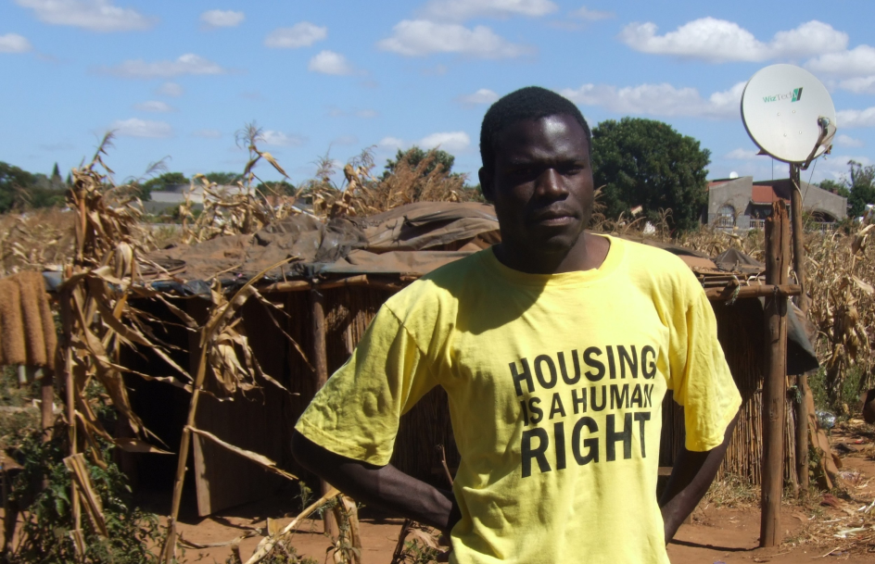
Satellite TV Use
Photo: www.rnw.nl

Slide 15
Two-Thirds of TV Owners Use a Satellite Dish
How does your television receive its signal?
Results among television owners (n=799)

Slide 16
Dish Ownership Prevalent Among Most Educated

Slide 17
One in Four Dish Owners Pays for Premium Channels
Do you use the TV channels that are aired for free with your satellite dish, or do you pay extra money to access more channels?
Results among satellite dish owners (n=558)
Notes:
Obviously, those with higher levels of education and those higher income are more likely to pay extra – including 44% of college graduates and 40% of those who say they are “living comfortably” on their present income.
Urban residents are somewhat more likely than rural residents to say they pay extra – 31% vs. 22%. Shona are about twice as likely as Ndebele to pay extra – 28% vs. 14%.

Slide 18
Shona, Highly Educated Most Likely to Pay Extra

Slide 19
Wiztech, DSTV Most Popular Satellite Decoders
Notes:
Those with higher levels of education and income are more likely to use DSTV – among college graduates, 45% use DSTV while 32% use Wiztech
In a couple of provinces – Manicaland and Midlands – DSTV decoders are more common than Wiztech. In Matabeleland in the east, however, no one uses DSTV – residents all use the Wiztech or Philibao decoders

Slide 20
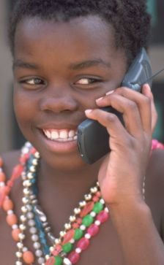
New Media: Internet & Mobile Phone Use
Photo: Dailymail.co.uk

Slide 21
Strong New Media Growth: Internet Use More Than Doubled Since 2011
Past-week use of source

Slide 22
Urban Areas in Particular Show High Use of TV and New Media
Past-week use of source

Slide 23
TV Is Leading News Platform in Urban Areas
Daily/Most days use of source to get news

Slide 24
TV, SMS, Internet are Leading News Platforms for the Highly Educated; Those under 30 Turn to Friends/Family
Daily/Most days use of source to get news

Slide 25
Mobile Phone Penetration Lower Among Older, Rural, Uneducated, and Ndebele Speakers
% Personally owning a mobile phone among various demographic groups

Slide 26
SMS Is the Primary Non-Voice Activity, but Internet Access, Social Networking, and Radio Listening Are Also Popular
Which of the following have you done on a mobile phone in the past 7 days?

Slide 27
Interest in Mobile News and Information

Slide 28
Mobile Is the Key Internet Access Means
In which of the following locations do you use the Internet?

Slide 29
Internet Use Highest Among Young Adults, Urbanites, and Highly Educated
% Having accessed the Internet during the past week among various demographics

Slide 30
News and Information Top the Internet Agenda
In the last 7 days, which of the following activities have you used the Internet for?

Slide 31
Young Adults More Likely to Frequently Share News With Others
How often do you discuss or share news with family, friends, or your social network, not including those who live in your household?

Slide 32
SMS and Facebook Are Key News-Sharing Tools for Young Adults in Particular
Do you share news with your friends, family, or social networks in any of the following ways?

Slide 33
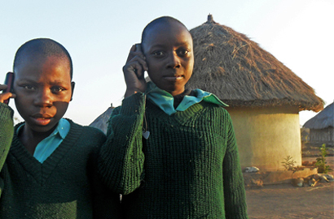
Conclusions
The notion that Zimbabwe is a radio-only market is outdated.
With the strong growth in TV and New Media in urban areas, a multi-platform approach is needed to reach different demographics.
Photo: voanews.com
Photo: biztechafrica.com
Gallup® is a trademark of Gallup, Inc. All other trademarks are the property of their respective owners.

Slide 34
Upcoming BBG Research Series Events
Upcoming BBG Research Series events:
Thursday, December 6: To be announced.
Learn more about the BBG Research series at http://j.mp/UjCmJb
Have a question? Contact us at 202-203-4400 or pubaff@bbg.gov

